Slide 1


DyPyBench, A Benchmark of Executable Python Software
Master Thesis Project of Piyush Bajaj
Examiner: Prof. Dr. Michael Pradel
Supervisor: Islem Bouzenia
Notes:
Hello everyone and welcome to the presentation on DyPyBench, a Benchmark of executable python software done as part of my Master Thesis.

Slide 2
Introduction : Background and Motivation
Benchmarks
Benchmarks for dynamic analyses
Existing dynamic benchmarks
SPEC benchmarks. [1]
DaCapo Benchmark. [2]
Python is a prime candidate for dynamic analyses
Popularity.
Dynamism.
Dynamic Benchmark for Python to perform dynamic analyses.
[1] https://www.spec.org/benchmarks.html
[2] https://www.dacapobench.org/
Notes:
In software development, benchmarks are standardized tests to measure performance in terms of speed, scalability and resource utilization.
There are two types of benchmarks based on performance, static and dynamic.
Dynamic benchmarks are used for dynamic analysis which study the run time properties of the system or application.
Some of the existing dynamic benchmarks are SPEC and DaCapo.
SPEC is used to measure the performance of C/C++ of different hardwares and DaCapo is used to measure performance of virtual machines and memory mgmt for Java.
Python presents itself as a prime candidate for dynamic analysis due to its wide spread usage, popularity and dynamic nature.
But it lacks dynamic benchmarks for complex applications, so we create a dynamic benchmark for Python.

Slide 3
Introduction : Challenges
Selection of Python projects from a large corpus.
Ensuring diversity of application domains.
Differences in setup and installation of projects.
Executing test suites. (Dynamic aspect)
Notes:
Let’s have a look at some of the challenges that we face to create such a benchmark.
Due to the popularity and wide spread usage of python, we have a lot of open source projects available to choose from.
This popularity comes due the usage of python in different application domains such as scripting, machine learning, game development, web development.. just to name a few. The benchmark must cover as many domains as possible.
The projects belonging to different domains have different setup and installation steps, which the benchmark needs to handle.
Finally, In order to perform dynamic analysis the test suite must be executable.

Slide 4
Introduction : Contribution
The First Dynamic Benchmark for Python.
Large-scale.
Diverse.
Ready to Run.
Ready to Analyze.
Extensible.
Long-term.
Compositional.
Notes:
We create a first dynamic benchmark for Python having the following properties:
It is large scale with 50 projects in total.
It contains projects from diverse application domains covered by python.
It is ready to run with a single command line interface.
It is ready to perform dynamic analysis.
It is easy to add new tools and projects to the benchmark.
It can be used long after the release.
It can perform analyses on one or more projects at the same time.

Slide 5
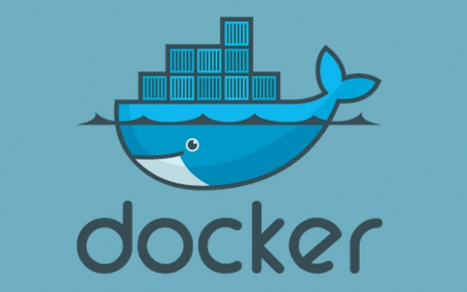
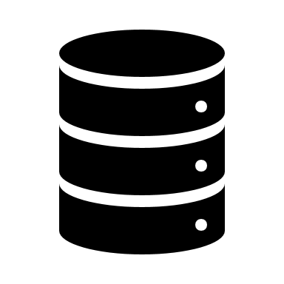


Approach
Usage of DyPyBench
Selection Criteria
Test Suite, Diverse domains, GitHub stars
Installation of Projects
Automation, Environments, Requirements
Integrating Analysis Frameworks and LExecutor
DynaPyt, PyCG
LExecutor
Trace File Generation
DynaPyt
Dynamic Analysis
Corpus of Python projects
Awesome Python
List of Python Projects
GitHub URLs, flags
Execution Environment
Installed Projects
Access Interface
List Projects, Run Tests, Run Analysis
Static Call Graphs
PyCG
DyPyBench
Notes:
To create such a benchmark, we follow the approach as shown in here.
We use the selection criteria, to filter out the projects from the corpus of awesome python.
This selection provides us a list of projects in the form of urls and flags.
We use these to install the projects and their dependencies through automation.
The installation provides us with an execution environment ready with projects to analyse.
We integrate Lexecutor and analysis frameworks, DynaPyt and PyCG to this environment.
Then we provide an access interface to list, run tests and analyses the projects.
We package the entire benchmark as a docker image.
We can use the integrated tools to generate trace files, perform dynamic analysis and generate call graphs.

Slide 6
Corpus of Python Projects
Collection of popular open source Python projects.
Awesome Python. [1]
Awesome Python Applications. [2]
Python Projects. [3]
Domain | No.
Testing | 30
Text Processing | 22
Science | 21
Code Analysis | 18
Debugging Tools | 18
Specific Formats Processing | 18
Command Line Tools | 17
GUI Development | 16
Database Drivers | 15
Image Processing | 15
Others... (82) | 483
Total | 679
[1] https://github.com/vinta/awesome-python/
[2] https://github.com/mahmoud/awesome-python-applications
[3] https://github.com/practical-tutorials/project-based-learning
Notes:
Let us now see some of the steps of the approach in more detail.
There are some repositories which provide a collection of popular open source python projects such as Awesome Python, Awesome Python Applications and Python Projects.
We use awesome python repository as the corpus for our benchmark, since it provides a pre classified collection of python projects based on application domains.
Here, in the table we can see some of the domains and number of projects present in the awesome python repository.
The total number of projects provided by this repository is 679 from 92 domains.

Slide 7
Selection Criteria (1)
Diversity.
Machine learning
Web development
GUI development, etc.
Popularity.
At least 500 stars.
Test suite.
Existing test suites.
Compatibility with Pytest.
Notes:
We use three selection criteria to select projects for our benchmark.
Firstly, we ensure the projects belong to different domains such as machine learning, web development and GUI development.
Next, we check the stars on the GitHub repository. We select the projects having at least 500 stars to ensure its popularity.
Finally, we check if the project contains a test suite and whether the test suite is compatible with pytest.
We select the project only if all the three criteria are met.

Slide 8
Selection Criteria (2)
Project | Domain | Stars | Test Suite
grab | Web Crawling | 2.2k | Yes
fabric | DevOps Tools | 13.7k | No
PythonRobotics | Robotics | 16.8k | Yes
Flask-api | RESTful API | 1.3k | Yes
mxnet | Deep Learning | 20.2k | No
gym | Machine Learning | 29k | No
schedule | Job Scheduler | 10.2k | Yes
pagan | Image Processing | 278 | No
pillow | Image Processing | 10.3k | Yes
Notes:
This table shows of the projects from the awesome python corpus.
We can see that the project fabric on line 2, does not satisfy the test suite criteria, so we do not include this project in our benchmark.
Similarly, the project gym fails the criteria of test suite.
The project pagan only has 278 stars on github, so we reject it.
The project pillow for example satisfies both the these criteria, so we choose this for our benchmark.
As can be seen from the second column, all the projects selected belong to different application domains.
This ensures the diversity criteria

Slide 9
Handling Differences (1)
Python Robotics
Flask-Api
git clone github.com/AtsushiSakai/PythonRobotics.git
virtualenv vm
source vm/bin/activate
pip install .
pip install -r requirements/requirements.txt
pip install pytest
pytest tests/
git clone github.com/flask-api/flask-api.git
virtualenv vm
source vm/bin/activate
pip install .
pip install pytest
pytest flask_api/tests
Notes:
Here, we see the steps involved in installing and running the test suite of the projects.
The general steps we follow are cloning the repository, creating and activating virtual env, install the project and dependencies and execution of the tests.
We see the differences highlighted in the red.
The url to clone are different and the folder to run the tests using pytest are different.
The python robotics projects performs an extra step of installing dependencies from the requirements file.
To handle these differences for automating the installation and execution of projects, we use a text file with certain flags.

Slide 10
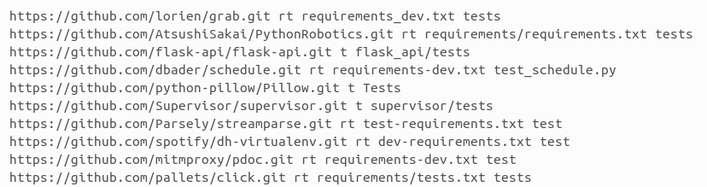
Handling Differences (2)
Notes:
Here, we see the text file with flags mentioned before to handle the differences for installation and execution of projects.
Each line in the file represents one project in the benchmark.
First flag shown in red specifies the github url to clone the source code.
The second flag shown in yellow can have two values rt or t, rt specifies the presence of requirement file, where t specifies the absence.
In case the second flag is rt, we specifiy the requirements file as shown in green.
We also specify the path of the test directory or file as the last flag, shown in blue.

Slide 11
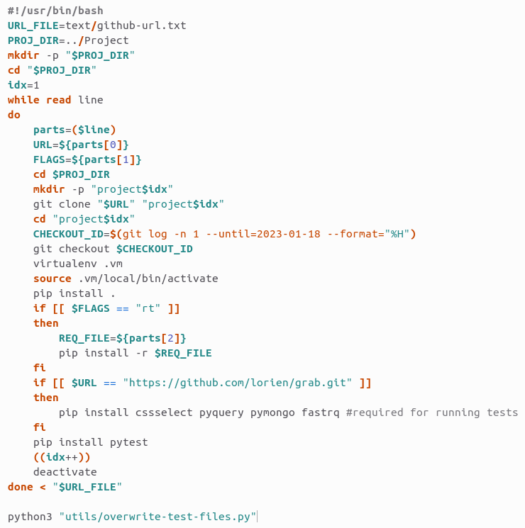
Installation (1)
Read line from file
Read flags from line
Git clone to date
Notes:
Next let us see the installation script we use to automatically install the projects for the benchmark.
First, we read the mentioned text file line by line.
For each line, we get the values of the different flags.
We create the directory for the project and clone the repository to that directory.
We clone to a specific date to ensure, the stability of the project for our use.
since, open source projects have frequent changes which can sometimes hamper installation or execution.

Slide 12
Installation (2)
Virtual environment
Check requirements flag
Install test requirements
Overwrite test cases
Notes:
After creating and activating a virtual environment, we install the project from the source.
We then check if the requirements file is present based on the flag, and install the dependencies from the file if needed.
We install other dependencies needed to run test suite of projects if needed.
We install the pytest library for execution of test suites.
Finally, we override some test files.
This is done to skip the test which fail to ensure proper execution of dynamic analyses.

Slide 13
Integrating Analysis Frameworks
PyCG
Call graph generation framework based on static analysis.
Installation and execution via bash scripts.
Output as a JSON file.
Caller == key and callees == values.
DynaPyt
Generic dynamic analyses framework using run-time hooks.
Two steps:
Instrumentation of files.
Execution of analysis.
Instrumentation and execution via bash scripts.
Folder or file to instrument indicated in text file.
Notes:
We integrate two analysis frameworks into the benchmark, PyCG and DynaPyt.
PyCG generates call graphs based on static analysis.
We provide automatic installation and execution of PyCG via a bash script.
The output is provided in the form of a JSON file, where key represents the caller and values represent the callees.
DynaPyt is a generic dynamic analysis framework based on run time hooks.
It works in two steps, instrumentation of files and then execution of analysis.
Bash scripts automate these steps in the benchmark.
The folders or files to instrument are listed in a text file for ease of handling.

Slide 14
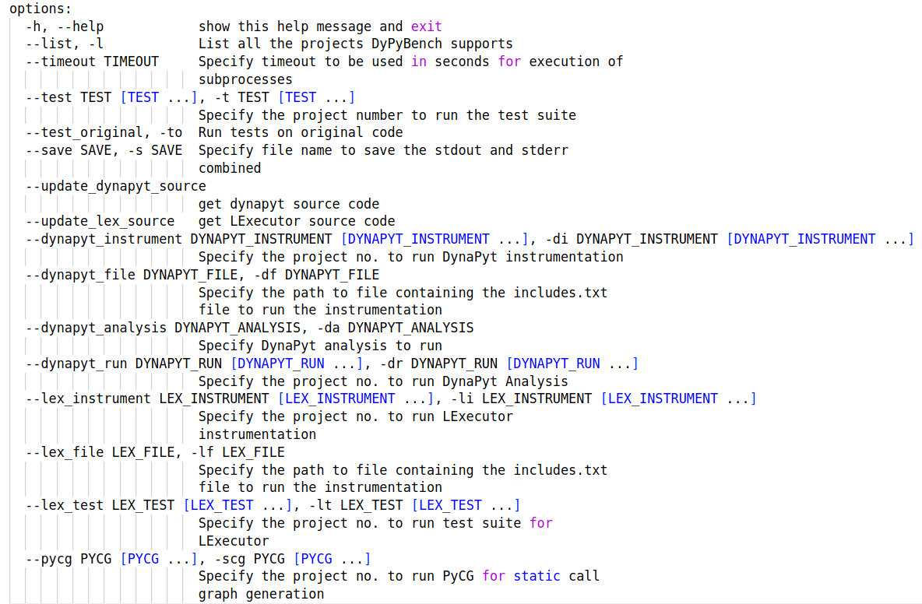
Access Interface
Single command-line interface.
Task execution on all or subset of projects.
Notes:
The access interface that the benchmark provides is a python script.
It is a single command line interface for the different operations in the benchmark.
It allows to specify operations on one or more projects at the same time.
The different options are shown on the right.
We can list the projects in the benchmark or specify timeout for analyses and tests.
We can save the output to a file, update dynapyt and lexecutor source codes.
We can also perform the different analyses using dynapyt, pycg and lexecutor.

Slide 15

Packaging and Export
Docker Image (13 GB)
Publicly available on Zenodo and Docker Hub.
50 projects + Analyses tools + Command-line interface.
Ready-to-run, ready-to-analyze.
Notes:
We package the benchmark as a Docker image which is about 13GB in size.
It is publicly available to use on Zenodo and Docker Hub.
The Docker image contains the 50 projects, along with the analyses tools and the command line interface.
The Docker image provides a ready to run and ready to analyse benchmark.

Slide 16
Evaluation
RQ1 : How the included test suites make our benchmark dynamic ?
RQ2 : Can our benchmark generate data for neural models ?
RQ3 : What are the application of analysis frameworks in our benchmark?
Notes:
We evaluate the benchmark created using the approach by answering the following.
How the included test suites make the benchmark dynamic in nature?
Can we use this benchmark to generate data for neural models?
What are the application of analysis frameworks provided in the benchmark ?

Slide 17
Evaluation : RQ1
Large number of executable tests : 45,086
High passing rate : 92%
Reasonable execution time : 71 seconds per test suite.
Low Runtime + High Pass Percentage = Dynamism of Benchmark
Notes:
To evaluate the dynamic nature of the benchmark, we study the available test suite of the projects.
There are a large number (45,086) of executable tests provided by DyPyBench.
The passing percentage of these tests is 92 %.
The execution time of test suite for each project is 71 seconds on average.
This low runtime of 71 seconds and high pass percentage of 92% makes DyPyBench dynamic in nature.

Slide 18
Evaluation : RQ2 (1)
Generate training data in the form of trace files for LExecutor.
Two steps:
Instrumentation
Execution
Number of data points collected : 547,830
% increase compared to base data points : 242%
Top-1 accuracy between 71.86% to 93.67% depending on validation data:
Random split : 5% data points from collected data points.
Project split : 6 projects not included in training, nearly 5% data points.
Original data : Validation data used LExecutor
Large Quantity of Data + Good Quality of Data = Valid Data Generator
Notes:
To evaluate if the benchmark can generate data for neural models, we generate training data in the form trace files for LExecutor.
Lexecutor, is learning approach that predict input values to execute arbitrary code snippets. It makes up to 5 predictions of each input variable.
It works in two steps, instrumentation and execution.
DyPyBench was able to collect 547,830 new data points to train the neural model which is a 242% increase compared to the data used by Lexecutor.
We get a Top-1 prediction accuracy in the range 71.86% and 93.67% depending on the validation data we use.
The first is a random 5% split of the total data points we collect from DyPyBench.
The second is a project split, where we selected 6 random projects in DyPyBench which contributed nearly 5% of the total data points.
The third is the one used by Lexecutor.
We get a large quantity of data and a good quality of data which makes DyPyBench, a valid data generator for neural models.

Slide 19
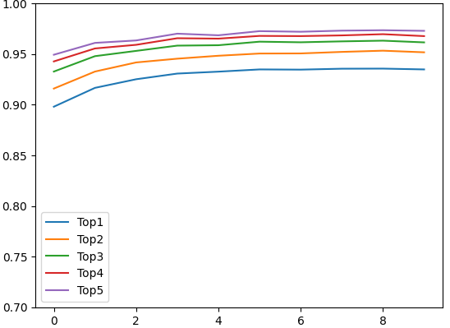
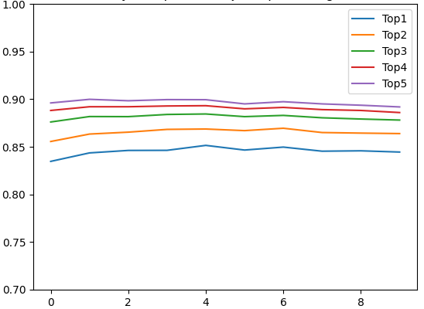
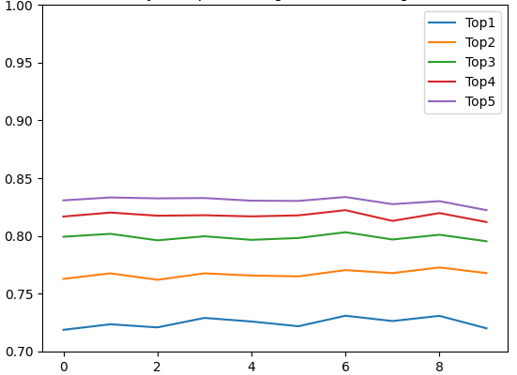
Evaluation : RQ2 (2)
Accuracy
Epoch
Epoch
Epoch
Random Split
Project Split
Original Data
Notes:
Let us have a look at the accuracy versus the epoch graphs for the three validation data sets we used.
For the random split, we see the accuracy of nearly 93% for Top-1 prediction and 97% for Top-5 predictions.
Whereas for the project split we see the accuracy of 84% for Top-1 prediction and 90% for Top-5 predictions.
Finally, for the original validation data, we see the accuracy for Top-1 prediction is around 72% and top-5 predictions is 84%.
The range of values are nearly comparable to the ones provided by Lexecutor which ranges from 82 to 94%,

Slide 20
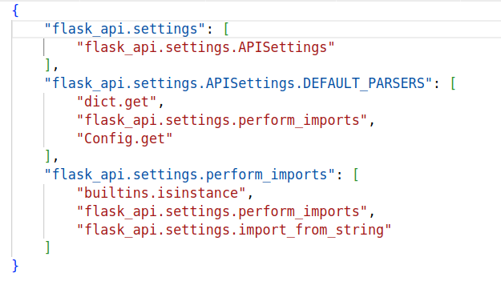
Evaluation : RQ3 (1)
Comparison of dynamic and static call graphs using DynaPyt and PyCG.
Notes:
To evaluate the application of analysis frameworks provide by DyPyBench, we compare the dynamic and static call graph.
The static call graphs are generated using PyCG whereas dynamic call graphs are generated using DynaPyt.
Here, we see the sample call graph structure.
The keys represents the callers are shown in blue, and the values represent the callees shown in red.

Slide 21
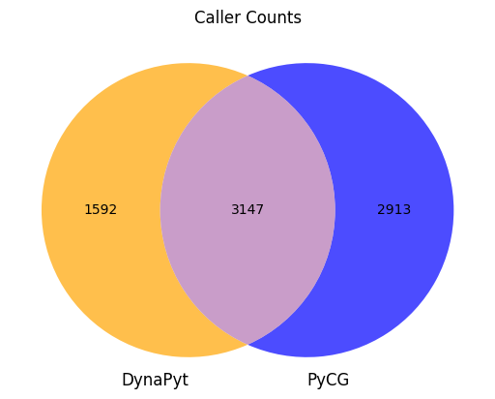

Evaluation : RQ3 (2)
Total : 7,652
Total : 13,420
Notes:
We compare the call graphs generated using DynaPyt and PyCG from 20 projects in DyPyBench.
Out of a total of 7,652 callers to compare 3147 match between the two, which is nearly 40 % of the total callers.
From these matching callers, we get 13,420 callees to compare out of which 2,938 match which is a mere 22%.
The number of these matches is less due to the limitations of the analysis tools used.
As a result we need to further compare the two outputs manually.
However, we see that DyPyBench provides an application of the analysis frameworks to compare static and dynamic call graphs.

Slide 22
Conclusion
We create a dynamic Python benchmark containing 50 projects from diverse domains.
The benchmark is preinstalled with code analysis tools such as DynaPyt, LExecutor and PyCG.
The code analysis tools can be easily accessed via a single command-line interface.
The benchmark can generate large and valid data for training neural models.
The benchmark makes it easier to perform analyses.
Notes:
To conclude, we create a dynamic benchmark for python with 50 projects from diverse domains.
The benchmark contains the code analysis tools such as DynaPyt, Lexecutor and PyCG.
These tools are easily accessible via a single command-line interface.
The benchmark can generate large and valid data for neural models.
The benchmark makes it easier to perform analyses.

Slide 23
Thank You

